Slide 1
REAL-TIME SURVEY INSTRUCTION MANUAL FIELDWORK MANAGEMENT rbfgambia.rtsurvey.com
Real-Time Analytics
Gambia
2018 - April

Slide 2
Table of contents
Dashboard
Fieldwork Management
Communication
Analytics and Reports
Final Deliverables
CSV Datasets
Stata Datasets

Slide 3
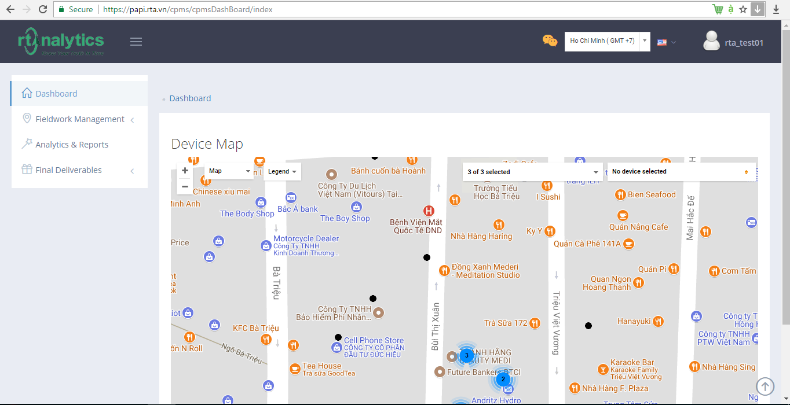

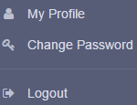
I. Dashboard (1)
After logging-in the site of papi.rta.vn by the account provided to each Survey owner, you’ll see the screen as following, you can change the language or your profile info and chat
Chat real- time

Slide 4
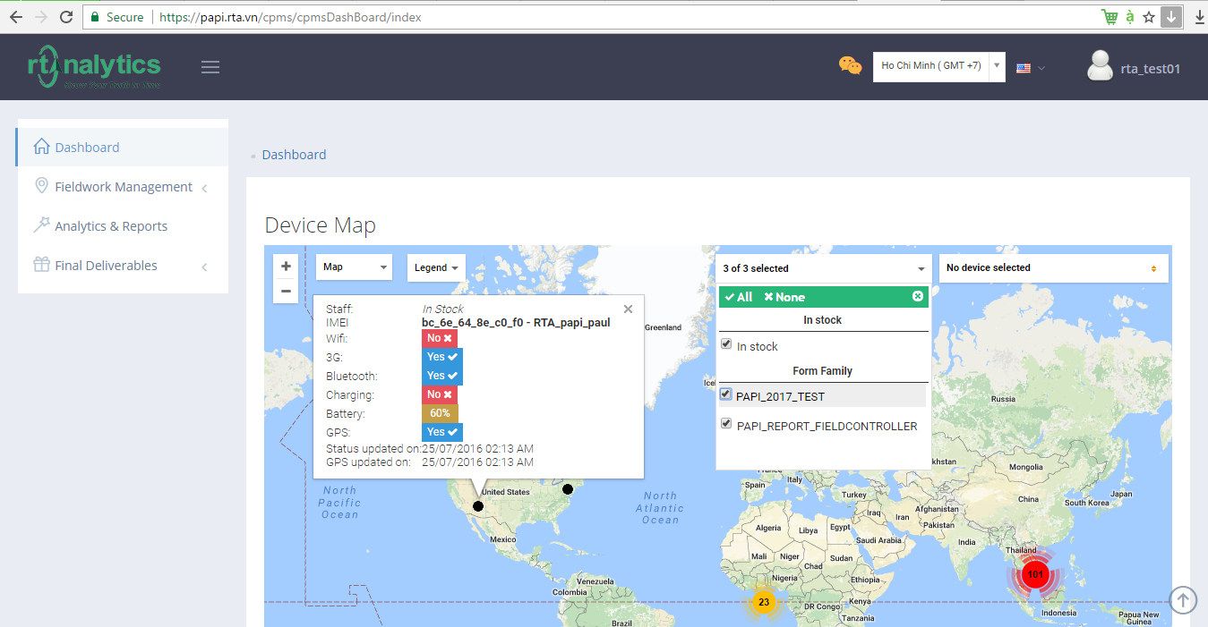
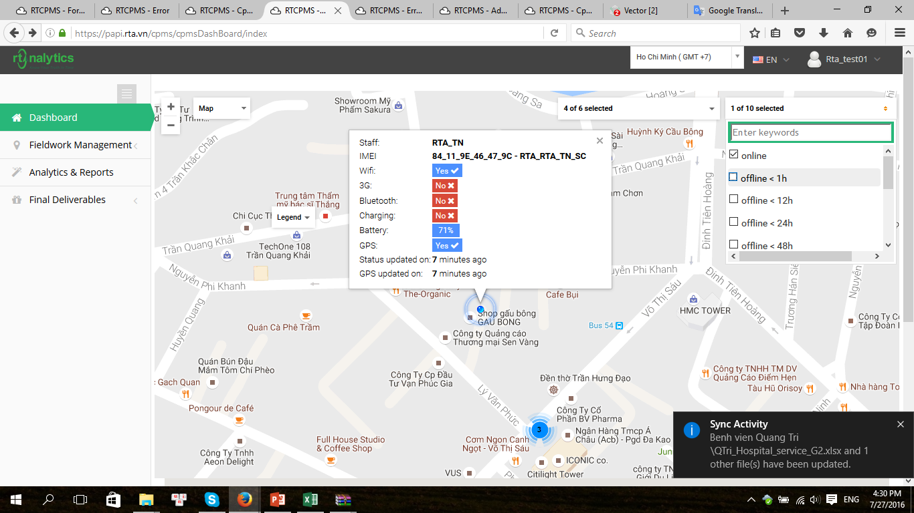
I. Dashboard (2)
On the Dashboard screen, you can check the location and on/offline status of tablets used of your project by choosing which form assigned to the tablets, and which status that you want to check (online/ offline < 1h/ offline < 12h, etc.)

Slide 5
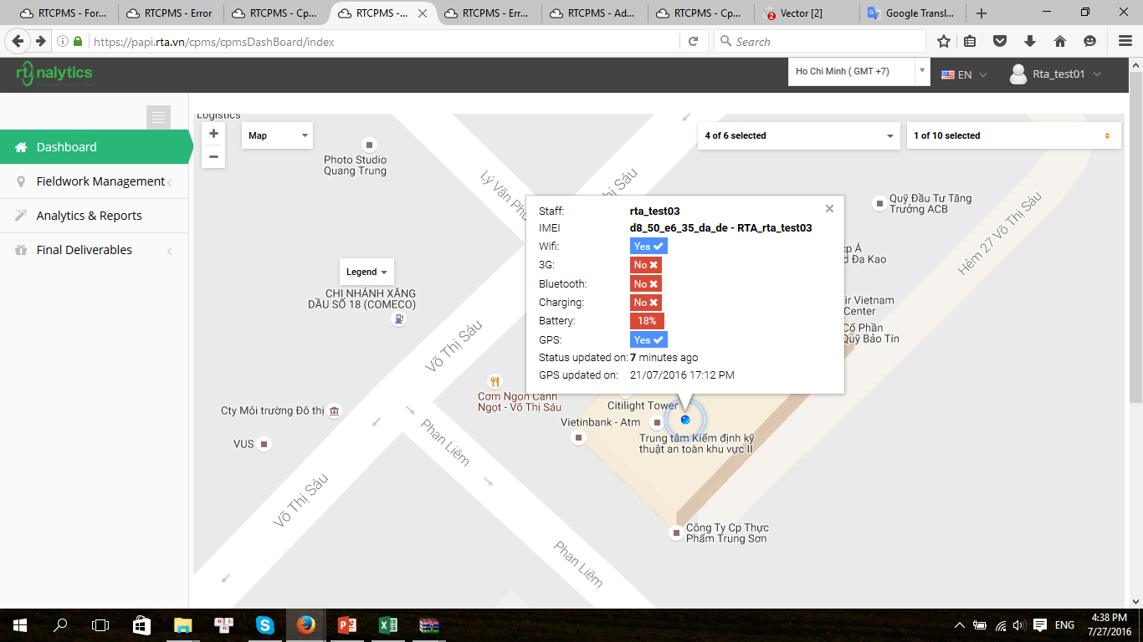
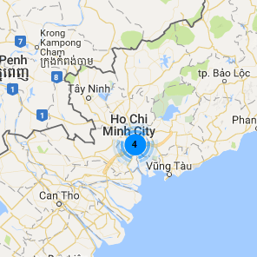
I. Dashboard (3)
For example, if choosing online devices, you’ll see the total number of devices that are currently online in a specific location. By clicking on that number, it’ll zoom in the device and its information like staff name, IMEI number, Wifi/ 3G status, etc.

Slide 6
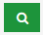
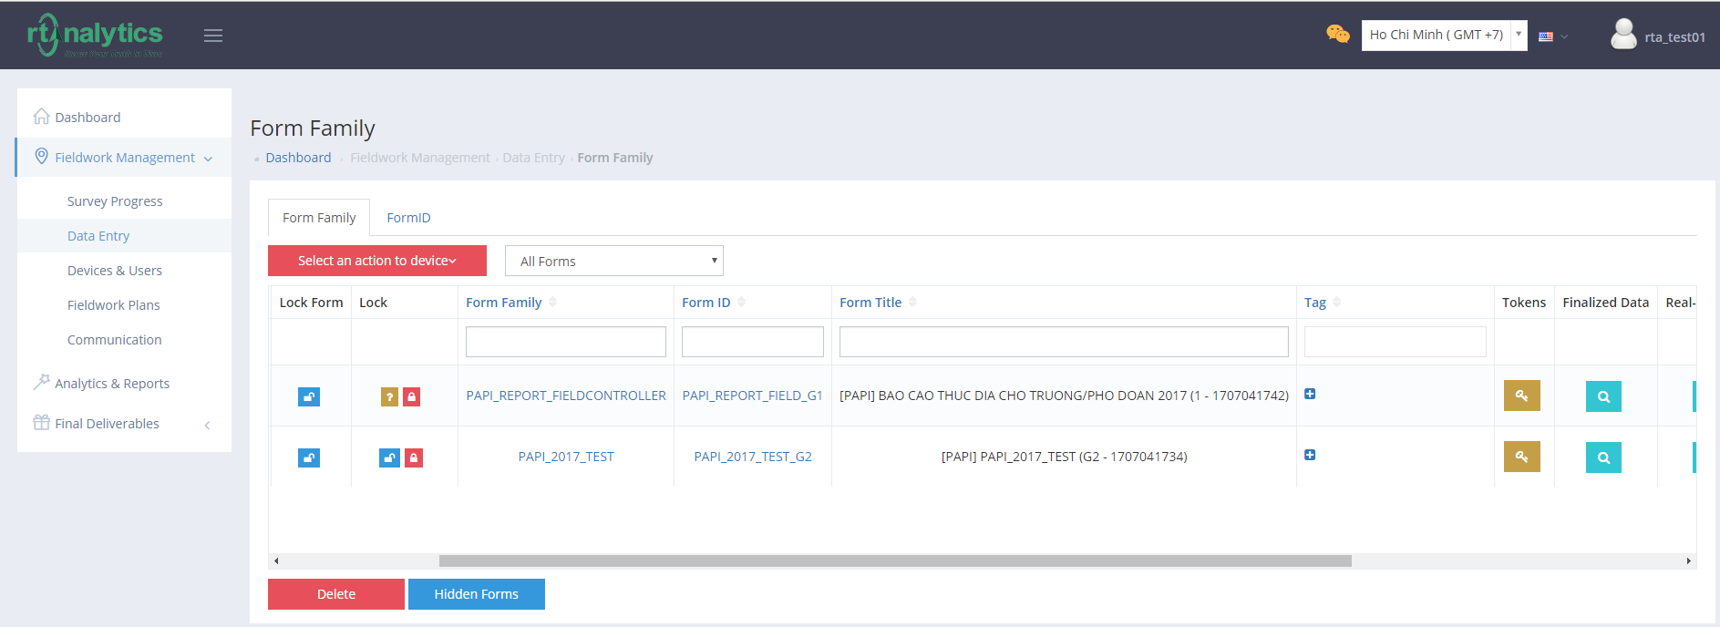

II. Fieldwork Management (1)
In order to hear recording files of instances submitted, you choose Fieldwork Management → Data Entry, then click on the button in Finalized Data column of which form that you want to follow up.

Slide 7
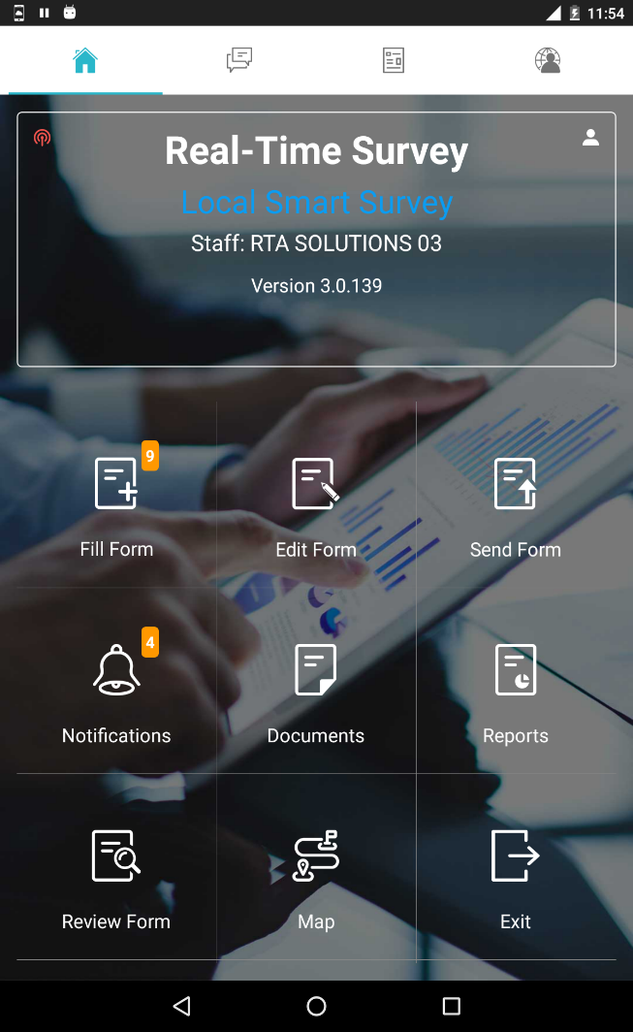
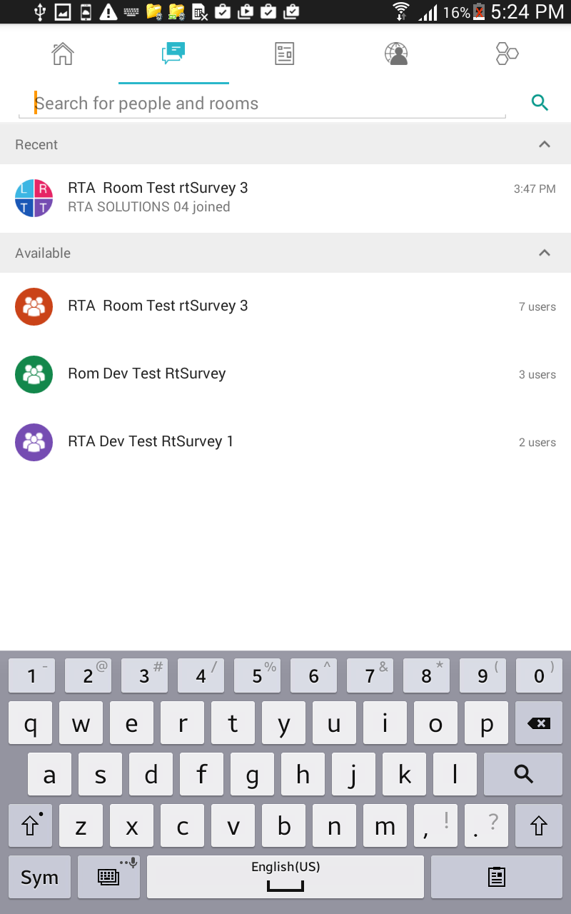
III. Communication (1)
Communication function is for exchanging information between users and supervisors.

Slide 8
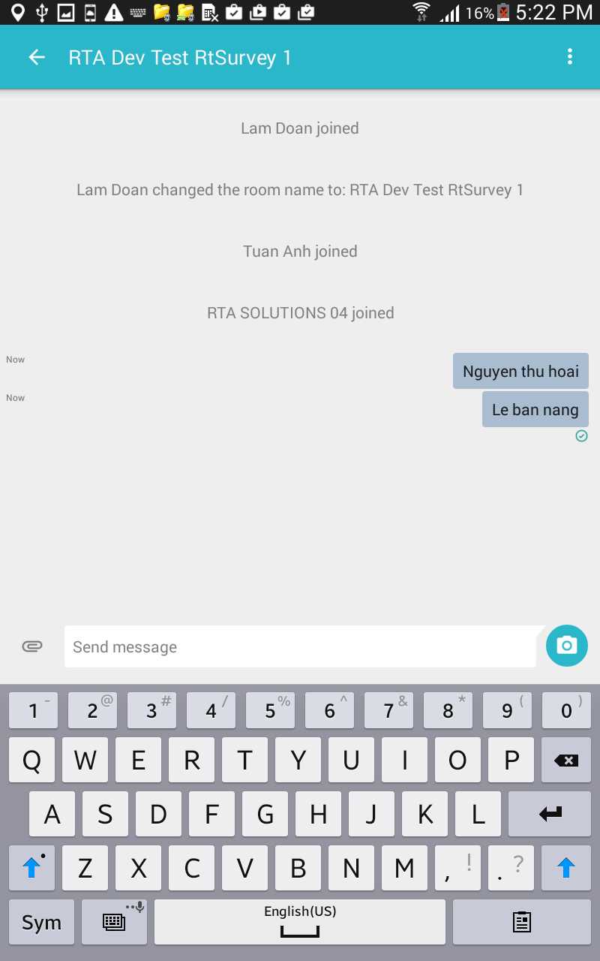
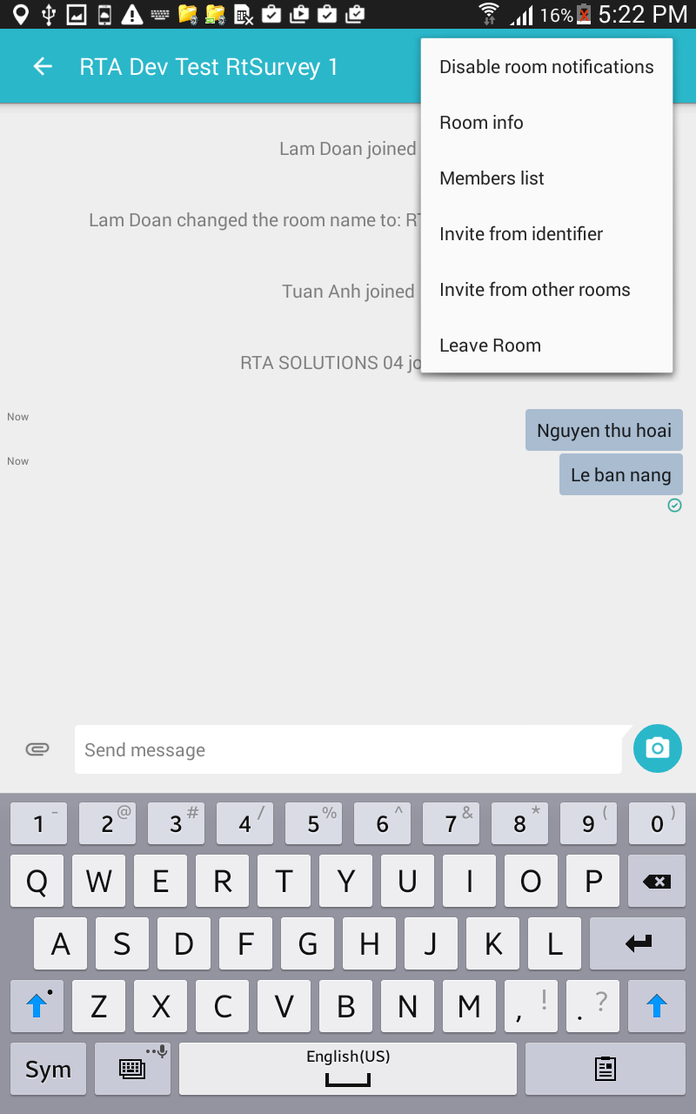
III. Communication (2)

Slide 9
4.3. Communication (3)

Slide 10
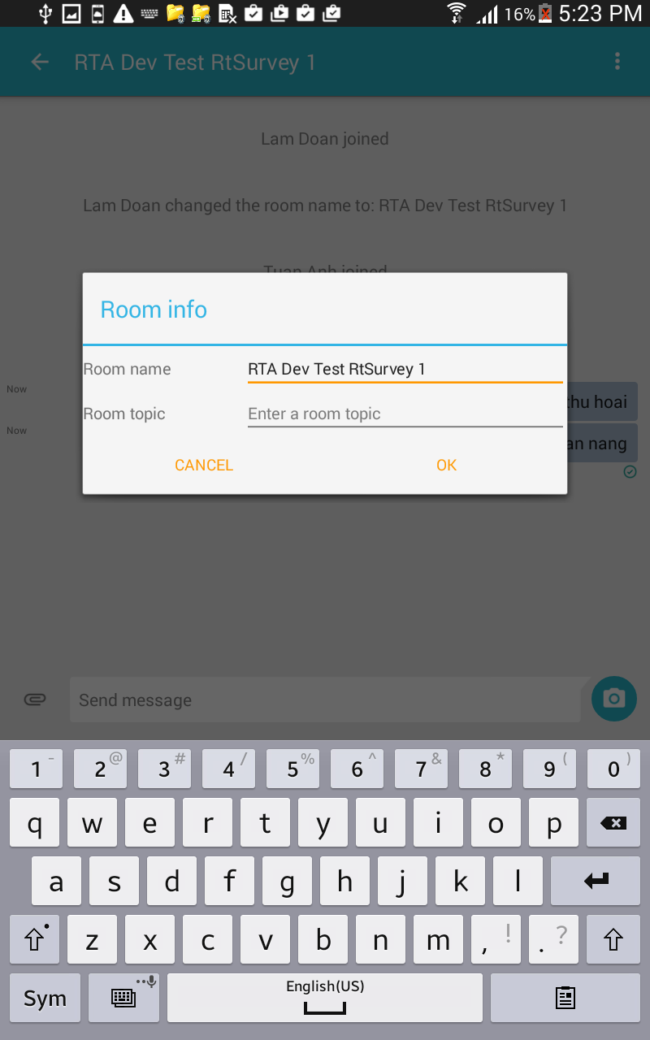
4.3. Communication (4)

Slide 11
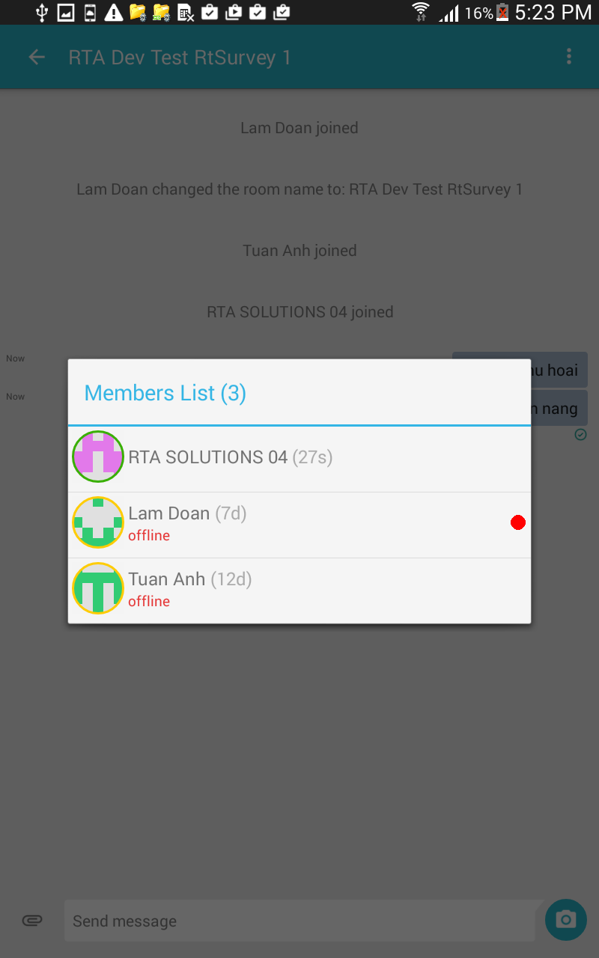
4.3. Communication (5)

Slide 12
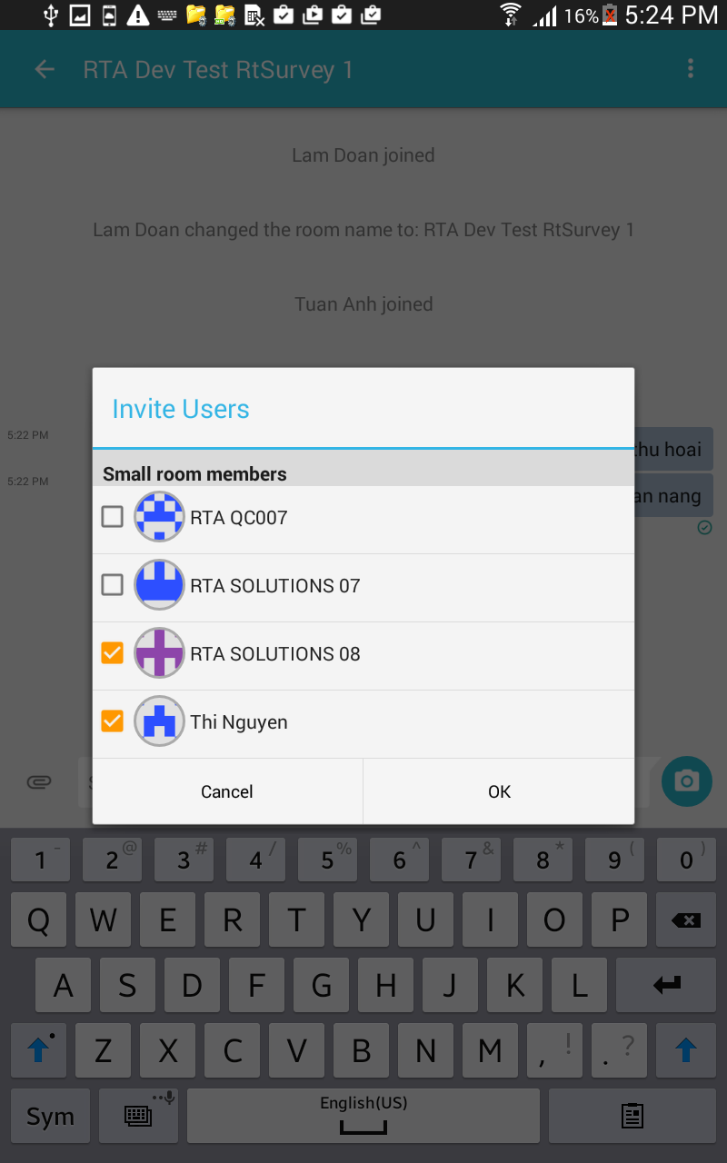
4.3. Communication (6)

Slide 13
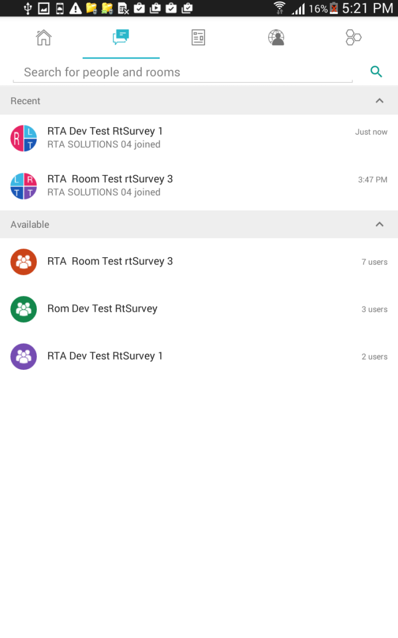
4.3. Communication (7)

Slide 14
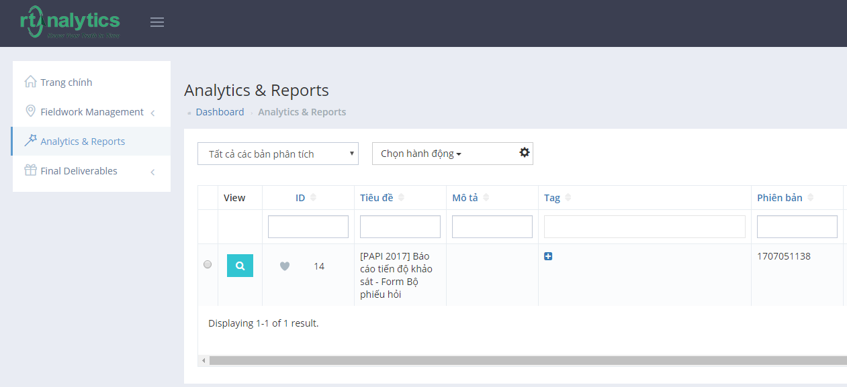
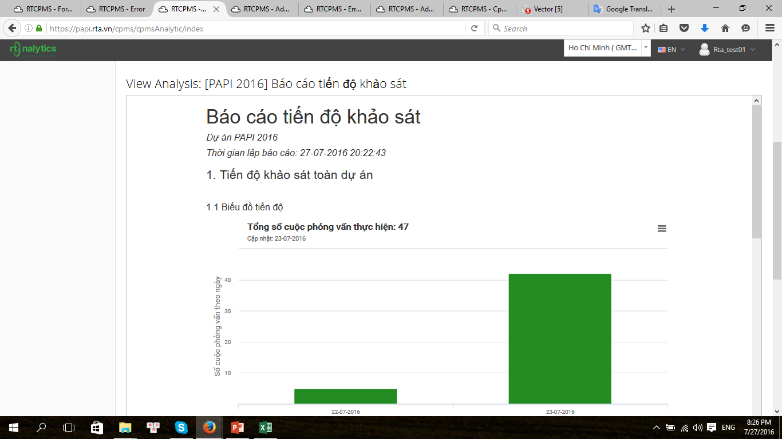
IV. Analytics and Reports (1)
In order to see the real-time reports for your project, you can go to Analytics & Reports, click on the button of which report you want to see, wait for a moment to generate it, and then scroll down the screen to see the report chosen.

Slide 15
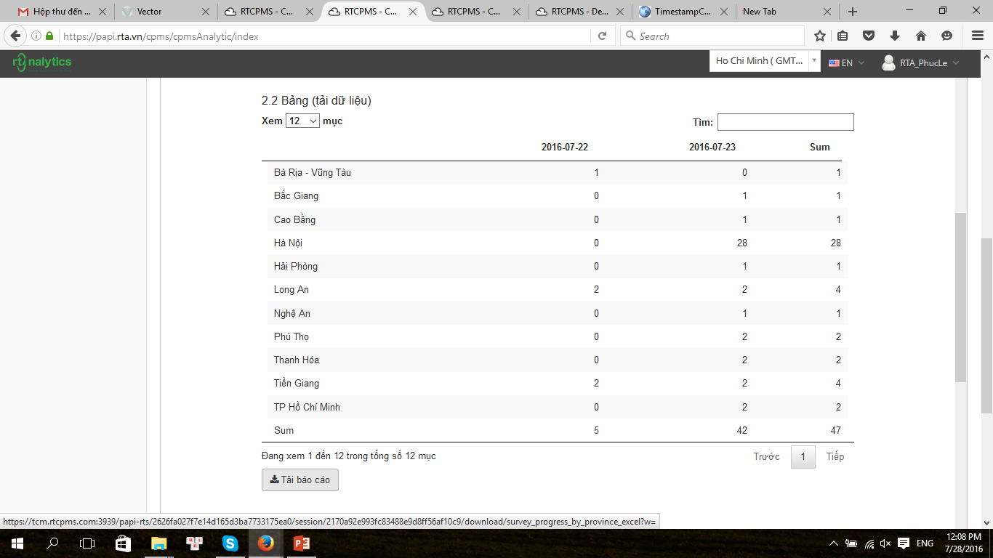
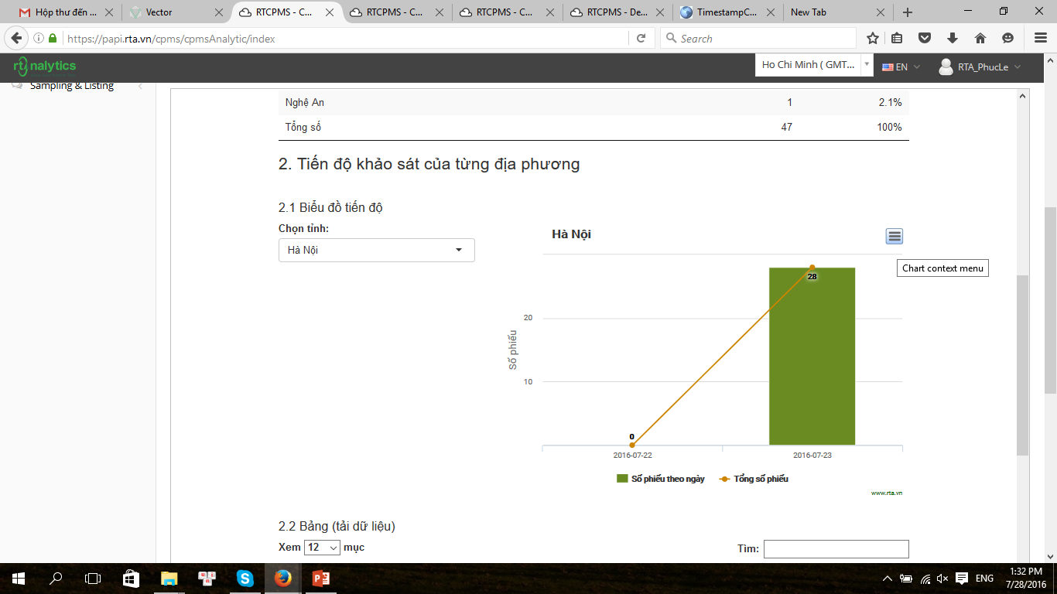
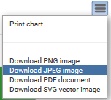
IV. Analytics and Reports (2)
You can also download table as excel file by clicking on the button below the table or the chart as image by clicking on the button and choose the type of image file that you want to save.

Slide 16
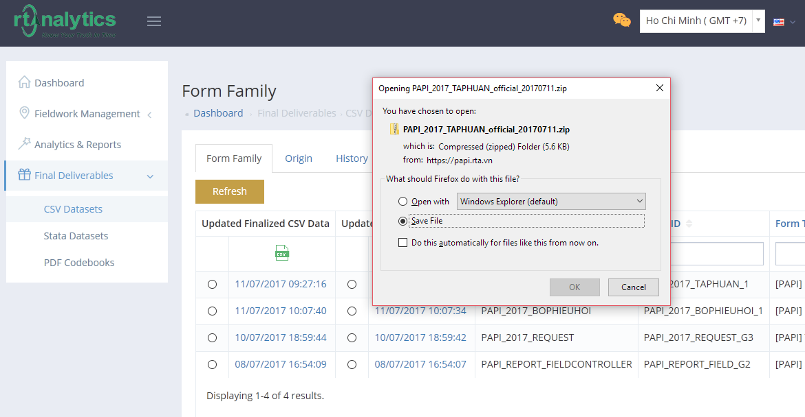
V. Final Deliverables
1. CSV Datasets
It’s possible for you to download the CSV Datasets of all interviews of your project. You just need to go to Final Deliverables → CSV Datasets → you’ll see the list of datasets in the Form Family tab. Then you just need to click on the date time showed in the column Updated Finalized CSV Data of that dataset → save file → Press OK
1
3
3
2
4

Slide 17
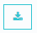
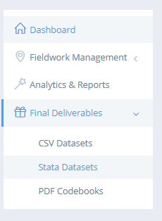

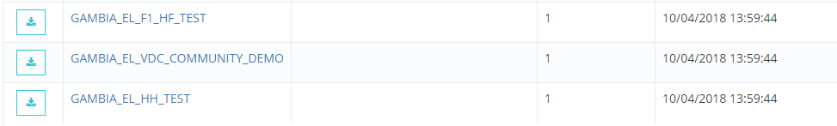

V. Final Deliverables
2. Stata Datasets (1)
Similarly, in Final Deliverables → Stata Datasets (*), you can download the dataset by clicking on the button in the Dataset column of the row displaying the form whose Stata dataset you want to download.

Slide 18
THANK YOU!
RTA Contacts:
Real Time Analytics
Address: Suite 1101-1102, 45 Vo Thi Sau st., District 1, Ho Chi Minh city, Vietnam
Email: info@rta.vn
Website: www.rta.vn

